Slide 1
CS2005 Database Systems
Fall 2021
National University of Computer and Emerging Sciences

Slide 2
CHAPTER 21
Concurrency Control Techniques

Slide 3
Introduction
Concurrency control protocols
Set of rules to guarantee serializability
Two-phase locking protocols
Lock data items to prevent concurrent access
Timestamp
Unique identifier for each transaction

Slide 4
21.1 Two-Phase Locking Techniques for Concurrency Control
Lock
Variable associated with a data item describing status for operations that can be applied
One lock for each item in the database
Binary locks
Two states (values)
Locked (1)
Item cannot be accessed
Unlocked (0)
Item can be accessed when requested

Slide 5
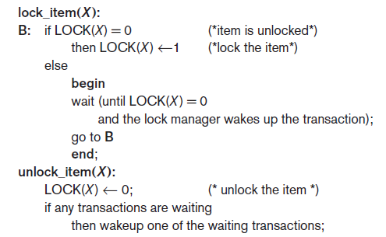
Two-Phase Locking Techniques for Concurrency Control (cont’d.)
Transaction requests access by issuing a lock_item(X) operation

Slide 6
Two-Phase Locking Techniques for Concurrency Control (cont’d.)
Lock table specifies items that have locks
Lock manager subsystem
Keeps track of and controls access to locks
Rules enforced by lock manager module
At most one transaction can hold the lock on an item at a given time
Binary locking too restrictive for database items
Notes:
<Data_item_name, LOCK, Locking_transaction>

Slide 7
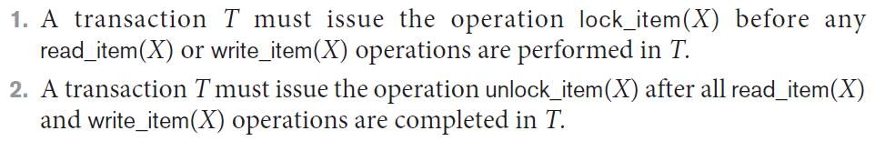
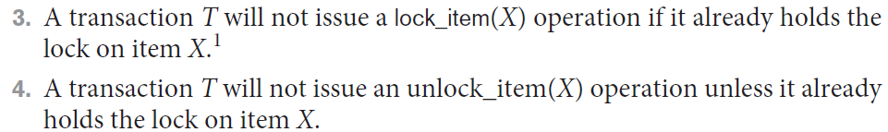
Two-Phase Locking Techniques for Concurrency Control (cont’d.)
If the simple binary locking scheme described is used, then every transaction must obey the following rules:
Notes:
Notice that the lock_item and unlock_item operations must be implemented as indivisible units (known as critical sections in operating systems); that is, no interleaving should be allowed once a lock or unlock operation is started until the operation terminates or the transaction waits

Slide 8
Two-Phase Locking Techniques for Concurrency Control (cont’d.)
Shared/exclusive or read/write locks or multi-mode locks
Read operations on the same item are not conflicting
Must have exclusive lock to write
Three locking operations
read_lock(X)
write_lock(X)
unlock(X)
Notes:
A lock associated with an item X, LOCK(X), now has three possible states: read-locked, write-locked, or unlocked
<Data_item_name, LOCK, No_of_reads, Locking_transaction(s)>

Slide 9
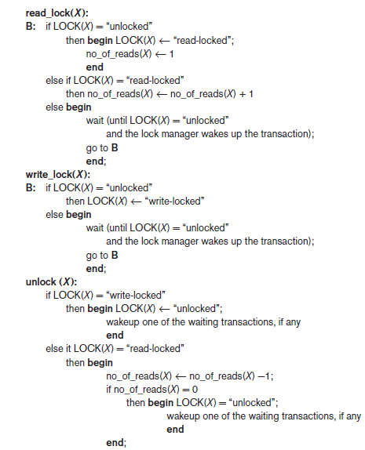
Figure 21.2 Locking and unlocking operations for two-mode (read/write, or shared/exclusive) locks

Slide 10
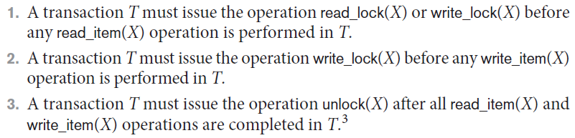
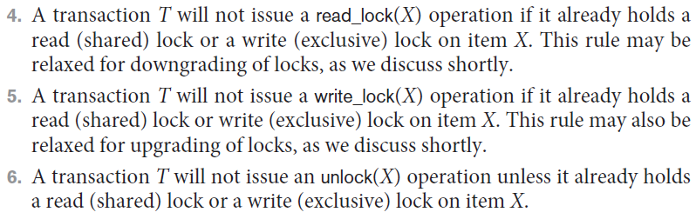
Two-Phase Locking Techniques for Concurrency Control (cont’d.)
When we use the shared/exclusive locking scheme, the system must enforce the following rules:

Slide 11
Two-Phase Locking Techniques for Concurrency Control (cont’d.)
Lock conversion
Transaction that already holds a lock allowed to convert the lock from one state to another
Upgrading
Issue a read_lock operation then a write_lock operation
If T is the only transaction holding a read lock on X at the time it issues the write_lock(X) operation, the lock can be upgraded; otherwise, the transaction must wait
Downgrading
Issue a read_lock operation after a write_lock operation

Slide 12
Using binary locks or read/write locks in transactions, as described earlier, does not guarantee serializability of schedules on its own.
Take an example in the next slide:

Slide 13
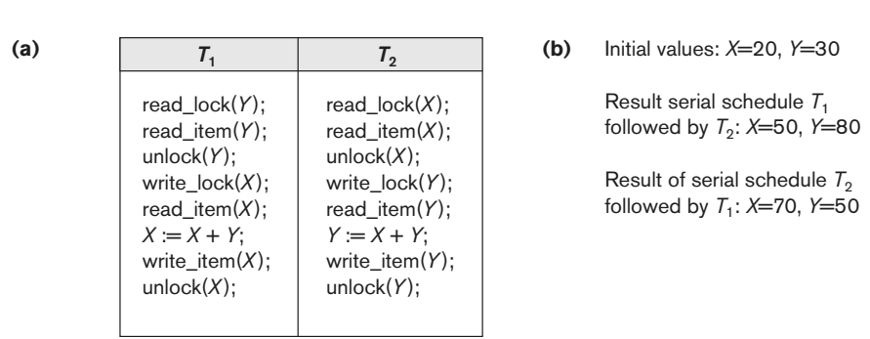

Slide 14
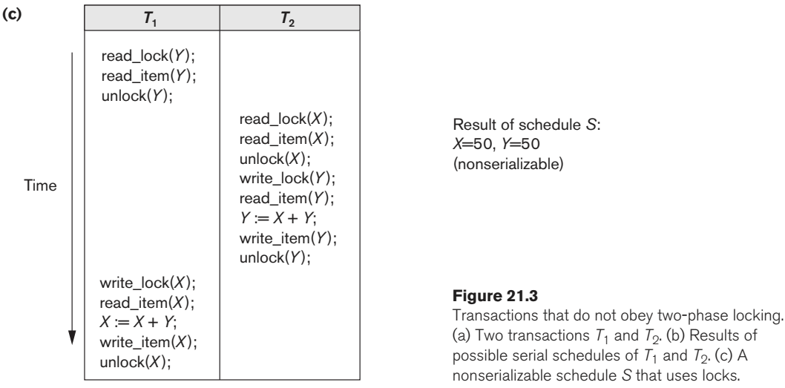

Slide 15
Guaranteeing Serializability by Two-Phase Locking (2PL)
Two-phase locking protocol
All locking operations precede the first unlock operation in the transaction
Expanding (growing) phase
New locks can be acquired but none can be released
Lock conversion upgrades (from read-locked to write-locked) must be done during this phase
Shrinking phase
Existing locks can be released but none can be acquired
Downgrades (from write-locked to read-locked) must be done during this phase

Slide 16
Guaranteeing Serializability by Two-Phase Locking (2PL)
If every transaction in a schedule follows the two-phase locking protocol, schedule guaranteed to be serializable
Two-phase locking may limit the amount of concurrency that can occur in a schedule
Some serializable schedules will be prohibited by two-phase locking protocol

Slide 17
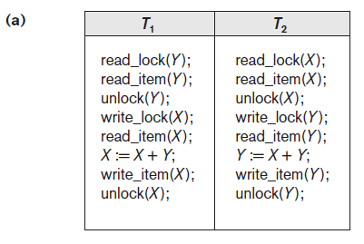

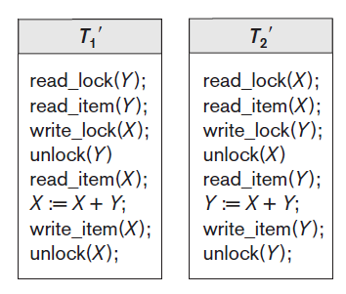
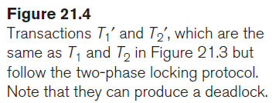

Slide 18
Variations of Two-Phase Locking (2PL)
Basic 2PL
Technique described on previous slides
Conservative (static) 2PL
Requires a transaction to lock all the items it accesses before the transaction begins
Predeclare read-set and write-set
If any of the pre-declared items needed cannot be locked, the transaction does not lock any item; instead, it waits until all the items are available for locking
Deadlock-free protocol
difficult to use in practice because of the need to predeclare the read-set and write-set, which is not possible in some situations.

Slide 19
Variations of Two-Phase Locking (cont’d.)
Strict 2PL
Transaction does not release exclusive locks (write locks) until after it commits or aborts. It is not deadlock-free.
Rigorous 2PL
Transaction does not release any locks (exclusive or shared) until after it commits or aborts
Concurrency control subsystem responsible for generating read_lock and write_lock requests
Locking generally considered to have high overhead
because every read or write operation is preceded by a system locking request

Slide 20
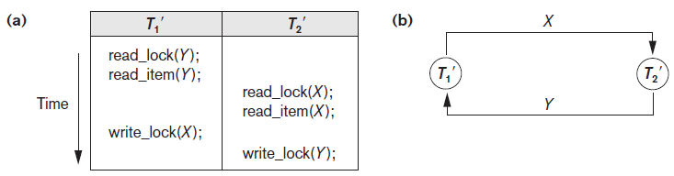
Dealing with Deadlock and Starvation
Deadlock
Occurs when each transaction T in a set is waiting for some item locked by some other transaction T’
Both transactions stuck in a waiting queue
Figure 21.5 Illustrating the deadlock problem (a) A partial schedule of T1′ and T2′ that is in a state of deadlock (b) A wait-for graph (WFG) for the partial schedule in (a)

Slide 21
Dealing with Deadlock and Starvation (cont’d.)
Deadlock Prevention Protocols
Every transaction locks all items it needs in advance - if any of the items cannot be obtained, none of the items are locked
A second protocol: Ordering all items in the database
Transaction that needs several items will lock them in that order
Both approaches impractical

Slide 22
Dealing with Deadlock and Starvation (cont’d.)
A number of other deadlock prevention schemes have been proposed that make a decision about what to do with a transaction involved in a possible deadlock situation:
these techniques use the concept of transaction timestamp TS(T′), which is a unique identifier assigned to each transaction.
if transaction T₁ starts before transaction T₂,
then TS(T₁) < TS(T₂).
NOTE: older transaction (which starts first) has the smaller timestamp value

Slide 23
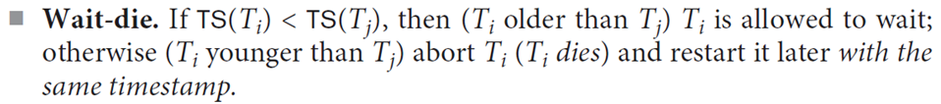
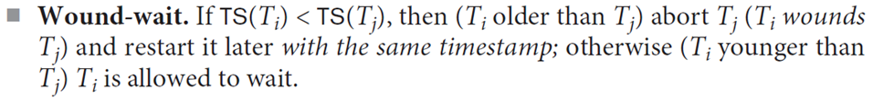
Dealing with Deadlock and Starvation (cont’d.)
2 Protocols based on a timestamp
Suppose that transaction T_{i} tries to lock an item X but is not able to because X is locked by some other transaction T_{j}
since in wait-die, transactions only wait for younger transactions so no cycle is created.
In wound-wait, transactions only wait for older transactions so no cycle is created.

Slide 24
In wait-die, an older transaction is allowed to wait for a younger transaction, whereas a younger transaction requesting an item held by an older transaction is aborted and restarted.
The wound-wait approach does the opposite: A younger transaction is allowed to wait for an older one, whereas an older transaction requesting an item held by a younger transaction preempts the younger transaction by aborting it.
Both schemes end up aborting the younger of the two transactions (the transaction that started later) that may be involved in a deadlock, assuming that this will waste less processing.

Slide 25
Dealing with Deadlock and Starvation (cont’d.)
No waiting algorithm
If transaction unable to obtain a lock, immediately aborted and restarted later
In this case, no transaction ever waits, so no deadlock will occur.
However, this scheme can cause transactions to abort and restart needlessly
Suppose that transaction Ti tries to lock an item X but is not able to do so because X is locked by some other transaction Tj with a conflicting lock
It can be shown that cautious waiting is deadlock-free, because no transaction will ever wait for another blocked transaction.

Slide 26
Dealing with Deadlock and Starvation (cont’d.)
Deadlock detection
System checks to see if a state of deadlock exists
Wait-for graph (a state of deadlock if and only if the wait-for graph has a cycle)
If the system is in a state of deadlock, some of the transactions causing the deadlock must be aborted. Choosing which transactions to abort is known as victim selection
Deciding which transaction to abort in case of deadlock (avoid selecting transactions that have been running for a long time) and that have performed many updates

Slide 27
Dealing with Deadlock and Starvation (cont’d.)
Timeouts
If system waits longer than a predefined time, it aborts the transaction
Starvation
Occurs if a transaction cannot proceed for an indefinite period of time while other transactions continue normally
Solution: first-come-first-served queue

Slide 28
21.2 Concurrency Control Based on Timestamp Ordering
Timestamp
Unique identifier assigned by the DBMS to identify a transaction
Assigned in the order submitted
Transaction start time
Concurrency control techniques based on timestamps do not use locks, so
Deadlocks cannot occur

Slide 29
Concurrency Control Based on Timestamp Ordering (cont’d.)
Generating timestamps
Counter incremented each time its value is assigned to a transaction
Current date/time value of the system clock
Ensure no two timestamps are generated during the same tick of the clock
General approach
Enforce equivalent serial order on the transactions based on their timestamps

Slide 30
Concurrency Control Based on Timestamp Ordering (cont’d.)
Timestamp ordering (TO)
Allows interleaving of transaction operations
Must ensure timestamp order is followed for each pair of conflicting operations
Each database item assigned two timestamp values
read_TS(X)
write_TS(X)

Slide 31
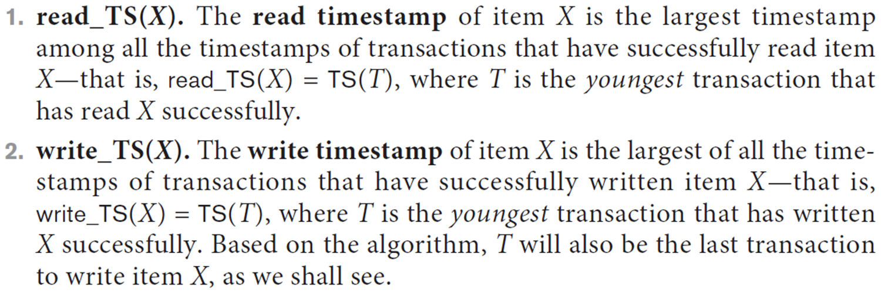

Slide 32
Concurrency Control Based on Timestamp Ordering (cont’d.)
Basic TO algorithm
Starvation may occur

Slide 33
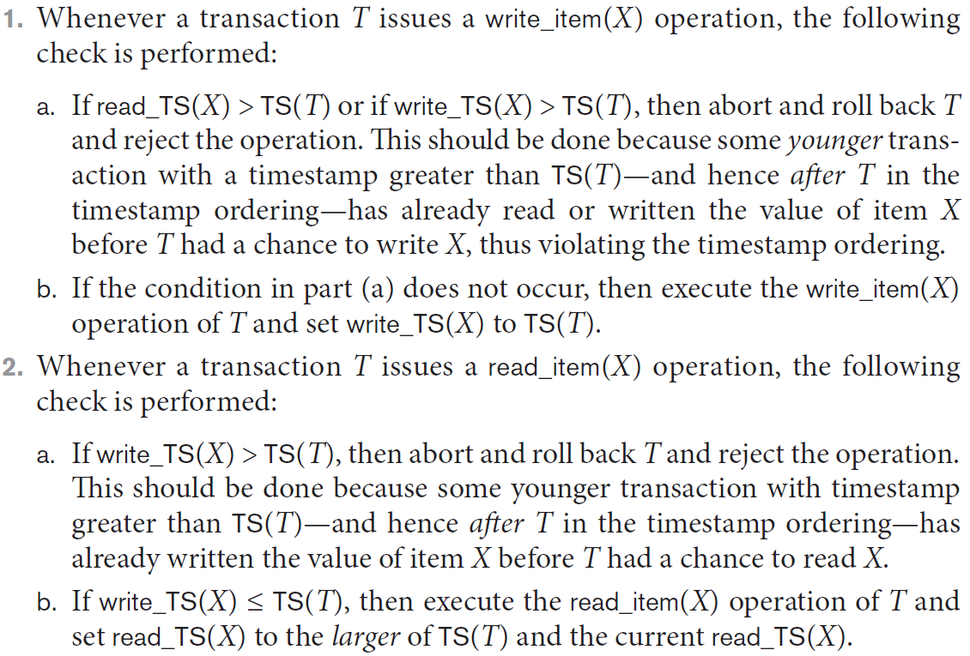

Slide 34
Concurrency Control Based on Timestamp Ordering (cont’d.)
Strict TO algorithm
Ensures schedules are both strict and conflict serializable

Slide 35
Concurrency Control Based on Timestamp Ordering (cont’d.)
Thomas’s write rule
Modification of basic TO algorithm
Does not enforce conflict serializability
Rejects fewer write operations by modifying checks for write_item(X) operation

